Slide 1
Real-Time Person Detection and Emergency Response System
TEAM – PLAYER1
Shreyas K Mitesh J Upadhya Priyansh Pratham kamani

Slide 2
PROBLEM STATEMENT
Real-time person detection and emergency alert system –
To detect individuals in distress or at risk in public or healthcare settings. Traditional security systems are reactive, relying on human intervention. This project aims to develop a real-time person detection and emergency alert system using YOLO for object detection and Gemini AI for analyzing emergency situations.

Slide 3
Overview of the Issue
Delayed Emergency Response : Many emergencies, such as falls or sudden illnesses, go unnoticed, especially when individuals are alone. Delays in identifying and responding to these events often result in worsened outcomes.
Monitoring Solutions:Existing systems like CCTV cameras or traditional monitoring devices lack intelligence . They provide raw data without meaningful interpretation or actionable insights.
Vulnerable Populations : The elderly, individuals with disabilities, and workers in hazardous environments are at higher risk . Current safety measures are reactive, not proactive, increasing vulnerability.

Slide 4
Real-World Examples
Healthcare : Elderly individuals often fall at home, with no one around to assist them . Falls account for 87% of fractures in people aged 65 or older, yet most incidents are reported too late.
Industrial Workspaces : Workers in high-risk jobs (e.g., construction, manufacturing) face hazards like falls, heavy machinery accidents. Slow detection of such events can lead to severe injuries or fatalities .
Public Safety : In crowded areas, emergencies like sudden collapses due to cardiac arrest or seizures may go unnoticed until it’s too late.

Slide 5
How it works?
Input Stage:Real-time video feed captures the environment through connected cameras.Frames are extracted and sent to the backend for analysis.
Object Detection (YOLO):YOLO model identifies individuals are present and sends frames to Gemini API for further processing
Contextual Analysis (Gemini AI):Evaluates detected individuals for emergencies (e.g., falls, immobility, injuries).Generates structured reports with severity scores and emergency flags.
Decision Logic:Identifies critical situations based on flags (e.g., "fallen," "unresponsive").Distinguishes between normal and emergency scenarios to avoid false positives.
Alerts and Response:Sends real-time notifications to the user interface for critical events.Highlights emergency type, severity, and suggested actions.
User Interface:Displays live video feed with visual overlays for alerts.

Slide 6
ARCHITECTURE

Slide 7
FRONTEND(HTML,CSS,JS)
HTML Framework - Provides structure for video feed, alerts, and controls.
CSS Styling (sec-style.css)Themes: Black background, white text, and green accents for visibility .
Responsive layout for mobile and desktop.
Header: Sticky title bar with shadowed text for branding.
Live Video Feed: Real-time display styled for focus and clarity.
Alerts & Status : Emergency popups with bold visuals
EmailJS : used to send emails when emergency is detected
.Responsive Design : Flexible layouts adapting seamlessly across devices.

Slide 8
Backend (Flask Server)-
Flask API: Provides an endpoint (/analyze) to receive image data from the frontend for processing.
YOLO Object Detection: Uses the YOLO model to detect people in the captured frames from the video feed.
Gemini AI Analysis: Sends images to Gemini AI for analyzing potential emergency situations (e.g., falls, unresponsiveness).
Emergency Detection: Analyzes the AI response to identify emergencies and returns a status to the frontend.

Slide 9
Image Processing -
YOLO Detection: Detects whether a person is present in the image.
Emergency Analysis: Uses Gemini AI to assess the physical condition of the person and identify potential emergency signs, such as trauma or immobility.
Communication Between Frontend and Backend -
Image Transmission: Captures 3 video frames every second and sent as image blobs to the Flask backend using fetch and Form Data.
Data Response: The backend sends a JSON response with detection results, including emergency status and relevant messages.
Deployment -
HTTPS Requirement: The system should be deployed over HTTPS to ensure camera access works smoothly across devices.
Backend Hosting: The Flask server can be deployed on cloud platforms like Heroku, AWS, or GCP for production use.
Frontend Hosting: The HTML, CSS, and JavaScript files can be deployed on static hosting services like GitHub Pages or Vercel.

Slide 10
FLAG DETECTIONS
- Fallen: The Individual Is On The Ground In A Manner Suggesting A Fall.
- Unresponsive: No Visible Reaction To External Stimuli.
- Critical Condition: Signs Of Life-threatening Distress Are Observed.
- Severe Risk: Conditions Pose A High Probability Of Harm.
- Potential Danger: Nearby Factors Could Harm The Individual.
- Motionless: The Person Has Not Moved For A Concerning Duration.
- Disoriented: The Individual Appears Confused Or Unsteady.
- Restricted Movement: Difficulty Or Inability To Move Body Parts.
- Potential Obstruction: Airway May Be Blocked Or Compromised.
- Labored Breathing: Noticeable Difficulty In Breathing.
- Seizure-like Activity: Repeated Involuntary Spasms Or Abnormal Movements.
- Visible Bleeding: Blood Is Clearly Seen, Indicating An Injury.
- Hazard Nearby: A Dangerous Object Or Situation Is Close To The Individual.
- Environmental Risk: Unsafe Surroundings Such As Fire, Water, Or Falling Objects.
- Sudden Collapse: Unexpected Falling, Suggesting A Serious Event.
- No Assistance: No Immediate Signs Of Risk; The Individual Appears Safe.

Slide 11
FUTURE SCOPE
Enhanced Detection Capabilities : Integrate audio analysis to identify verbal distress signals (e.g., calls for help).
Multi-Camera Integration : Support for multi-camera setups for comprehensive monitoring across larger areas.
Mobile Applications : Develop mobile apps for real-time alerts, monitoring, and remote access to data.
Integration with IoT Devices : Collaborate with wearable devices and smart home systems to provide a holistic safety network.
Collaborative Emergency Services : Establish APIs for direct integration with emergency responders for real-time intervention.
Data-Driven Insights : Use anonymized data to improve AI models and provide predictive safety analytics.
Broad Applicability : Adapt system for diverse use cases: healthcare, education, transportation, and disaster management.

Slide 12
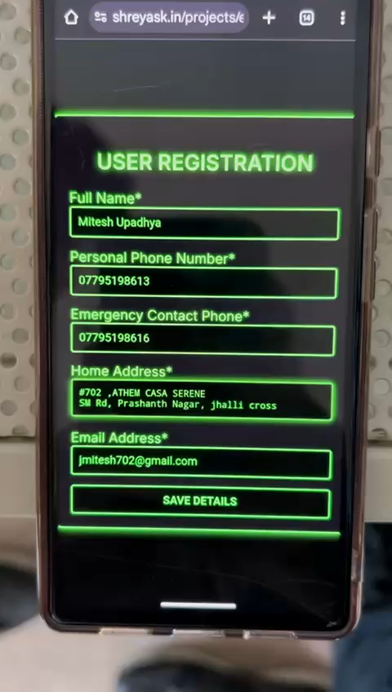
LIVE DEMO
TRY OUT THE DEMO
https://shreyask.in/projects/emergency-response-system/

